Slide 1
What is genomic epidemiology?
EMD 531
Lecture 1
nathan grubaugh, phd

Slide 2
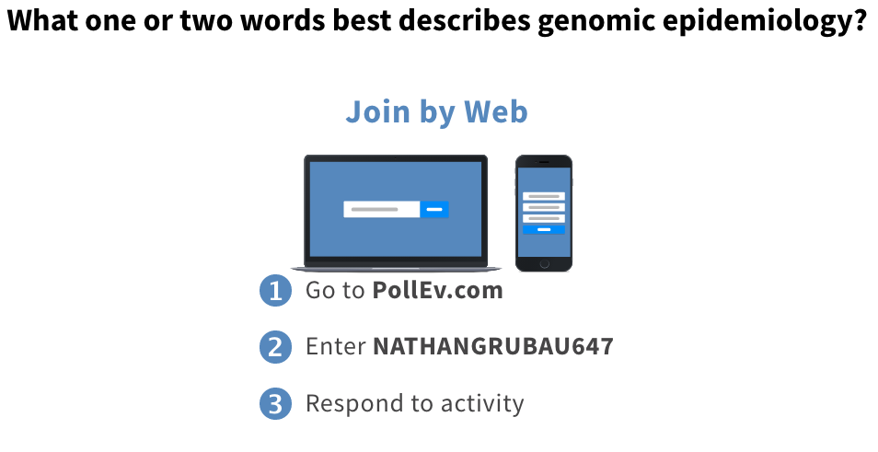

Slide 3
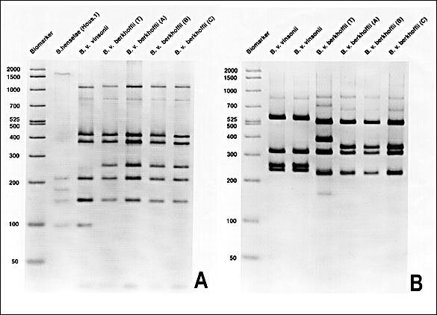
This is not molecular epidemiology
Kordick & Breitschwerdt, 1998. Persistent Infection of Pets within a Household with Three Bartonella Species. Emerging Infectious Diseases

Slide 4
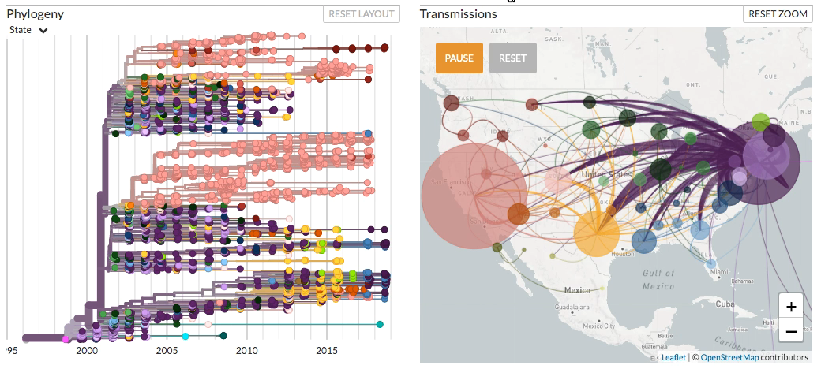
This is genomic epidemiology

Slide 5
Pathogen genomics for public health

Slide 6
Pathogen genomics revolution in public health
Needs:
Earlier detection and more precise investigation of outbreaks
More detailed knowledge of pathogen evolution and spread to inform control
Rapid diagnostics for individualize medicine
Standardized assays

Slide 7
Pathogen genomics revolution in public health
Needs:
Earlier detection and more precise investigation of outbreaks
More detailed knowledge of pathogen evolution and spread to inform control
Rapid diagnostics for individualize medicine
Standardized assays
Why genomics, why now?
Growing repositories of pathogen genomic data
Growing knowledge of genes/mutations linked to phenotypes
Decreasing costs of high-throughput sequencing
Increasing availability of useful analytical tools

Slide 8
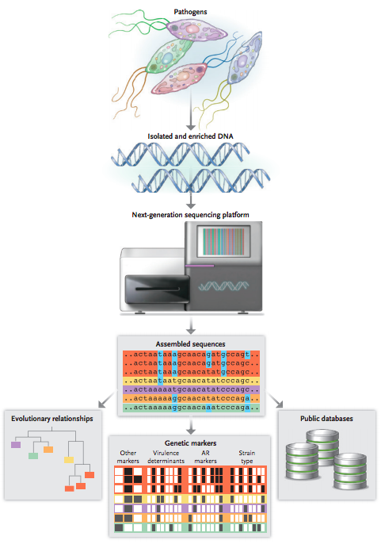
Pathogen genomic process
“Wet” lab:
Microbial isolation
RNA or DNA extraction
Library preparation
Sequencing
“Dry” lab:
Data processing
Primary genomic analyses
Data interpretation
Armstrong et al., 2019. Pathogen genomics in public health. New England Journal of Medicine

Slide 9
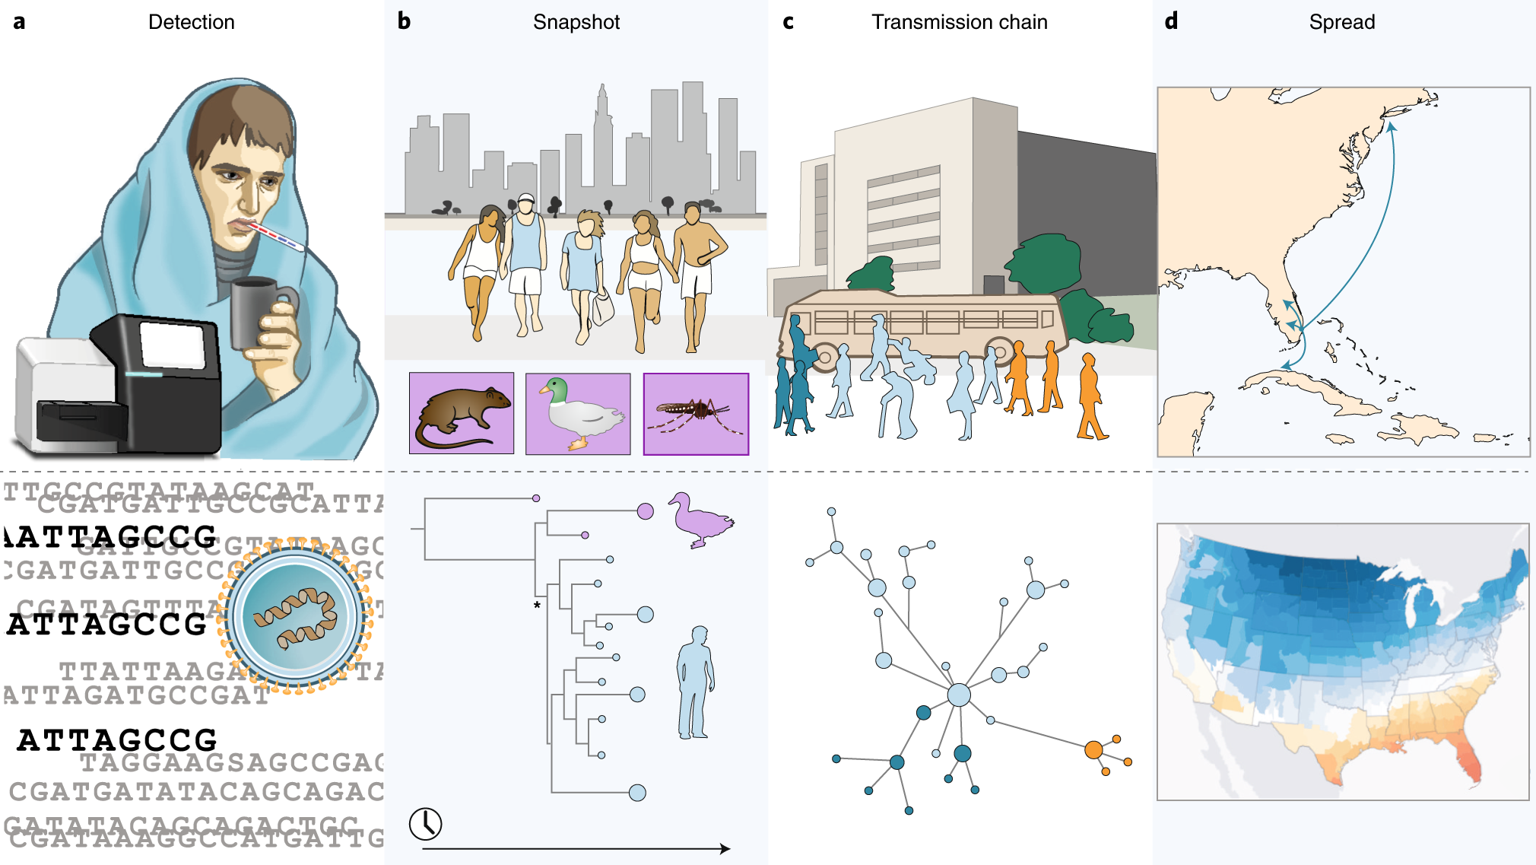
Pathogen genomic applications
Grubaugh et al., 2019. Tracking virus outbreaks in the twenty-first century. Nature Microbiology

Slide 10
Pathogen genomic applications
Detection
Discovery of a novel coronavirus associated with a cluster of pneumonia cases (n=59) linked to a fish market (?) in Wuhan, China (happening now)
Detection of MRSA isolates associated with an outbreak in a neonatal intensive care unit (case study)
Identification of chikungunya virus as an unrealized cause of pediatric meningitis in Bangladesh (case study, guest lecture)

Slide 11
Pathogen genomic applications
’Snapshot’
Ebola relapse post-mAb treatment linked to a latent virus infection (happening now, guest lecture)
Lassa fever cases linked to independent spillovers from animal reservoir, not human-to-human transmission (case study)
Congenital Zika syndrome cases in Angola linked to a virus introduction from Brazil (case study, guest lecture)

Slide 12
Pathogen genomic applications
Transmission chain
Mapping tuberculosis strain transmission to uncover the drivers of the MDR tuberculosis epidemic in Shanghai, China (case study, guest lecture)
Near real-time monitoring of HIV transmission clusters to support public health responses in BC, Canada (case study)
Identification of bacterial transmission pathways to investigate a persistent hospital and community outbreak (case study)

Slide 13
Pathogen genomic applications
Spread
Mapping the global evolution and spread of artemisinin resistant malaria (case study)
Reconstructing the emergence and history of HIV-1 in North America (case study)
Uncovering the epidemiological factors that spread and sustained the West Africa Ebola epidemic (case study)
Grubaugh et al., 2019. Tracking virus outbreaks in the twenty-first century. Nature Microbiology

Slide 14
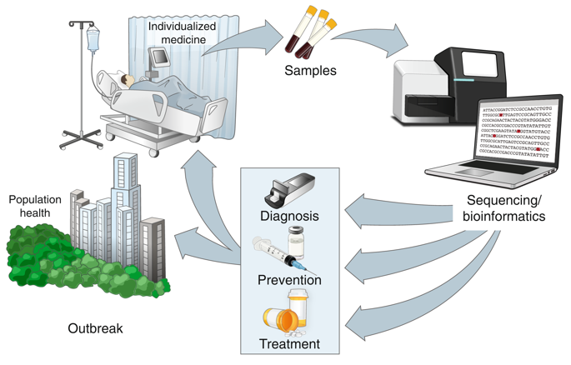
The future of genomic precision epidemiology
Ladner et al., 2019. Precision epidemiology for infectious disease control. Nature Medicine

Slide 15
There is an outbreak of Disease X: How do we make decisions based on limited data?

Slide 16
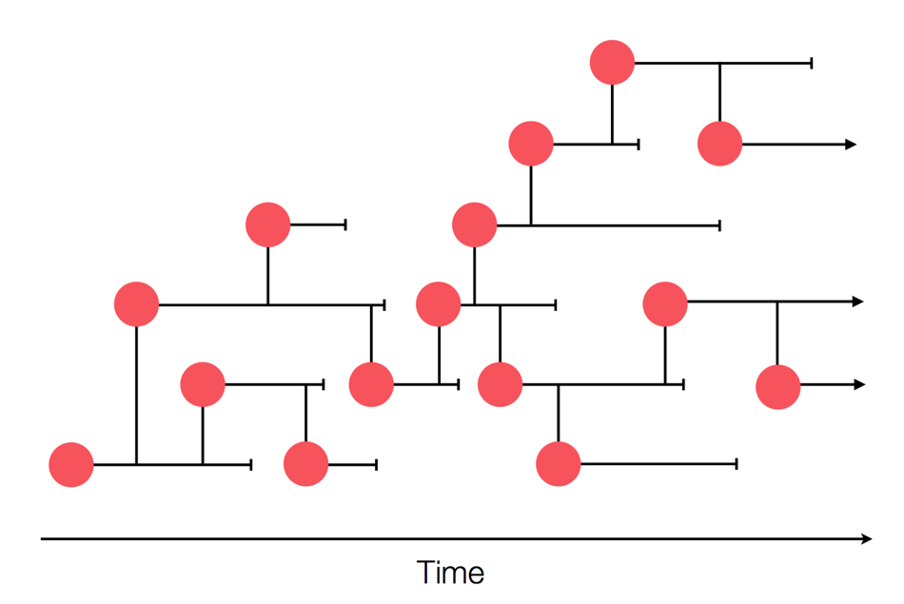
True transmission network
Credit: Trevor Bedford

Slide 17
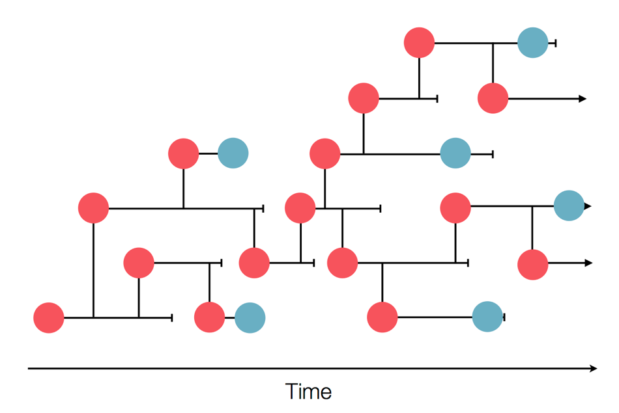
Surveillance network

Slide 18
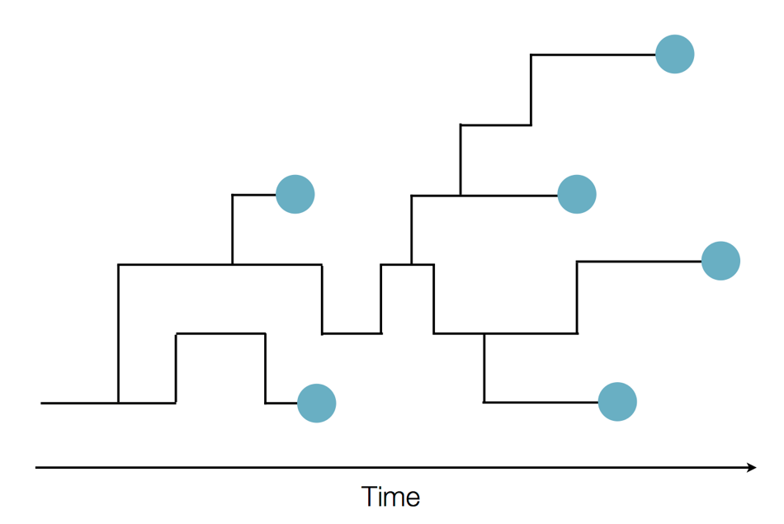
Unknown transmission network

Slide 19
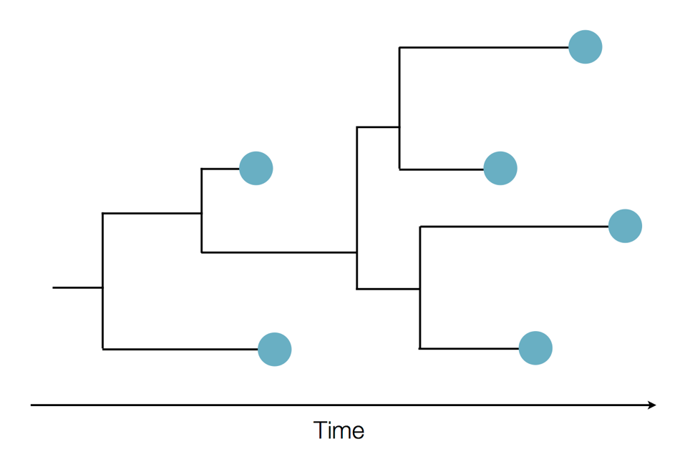
Putting the pieces together

Slide 20
Outbreak reconstruction

Slide 21
The course: what to expect, how to succeed

Slide 22
What you will learn
Concepts
Microbial evolution
Next-generation sequencing
Data to Phylogenetics
Methodology
Metagenomics
Alignments
Phylogenetic reconstruction
Tree annotation
Data visualization
Measuring selection pressures
Applications
Pathogen/trait detection
Outbreak/epidemic investigation
Critically evaluate gen epi investigations
How/when is genomic data helpful?
Are the data/methods appropriate?
How do the results inform decisions?
How to convey info to the public?

Slide 23
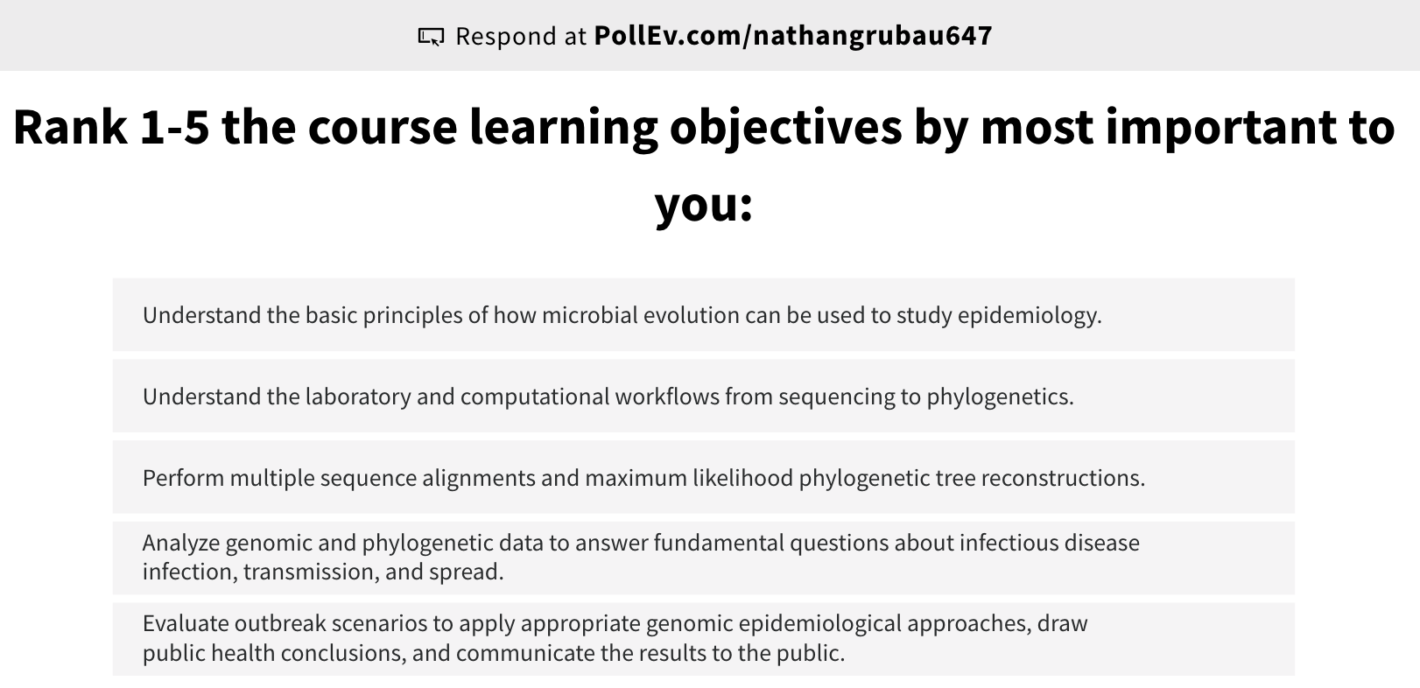

Slide 24


Instructors
Bios: http://grubaughlab.com/team/

Slide 25
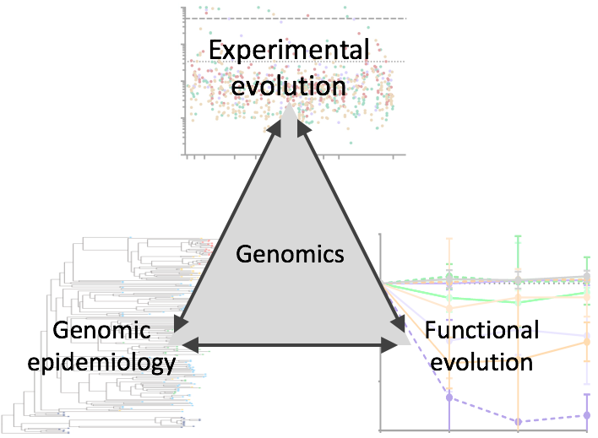
We use virus genomics to study epidemiology

Slide 26
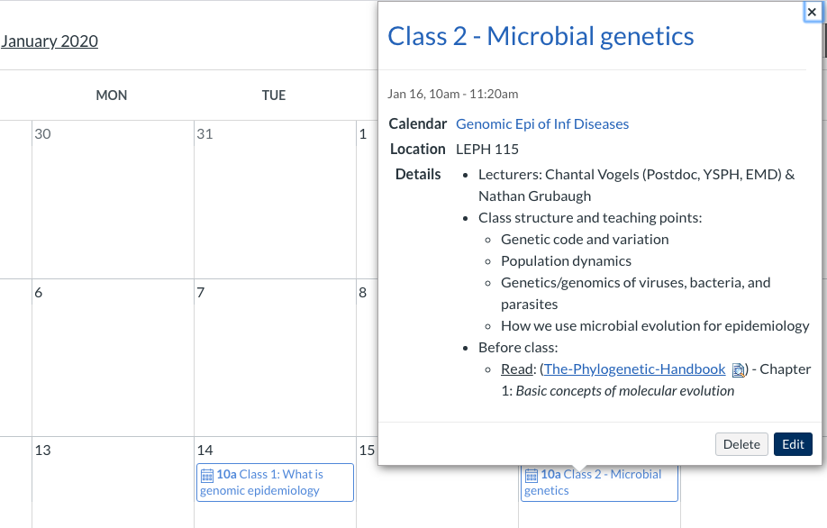
Where to find info?
Canvas: all files are (or will be) uploaded and linked to each class
Archive: https://github.com/grubaughlab/EMD531_Gen-Epi-Inf-Dis

Slide 27
Readings
The Phylogenetic Handbook
PDF provided, can buy used copies on Amazon
This is not a phylogenetics course:
Not all chapters covered in class, encourage further reading.
Utilize practices
Online tutorials
Review articles
PDFs provided
Primary literature
PDFs provided

Slide 28
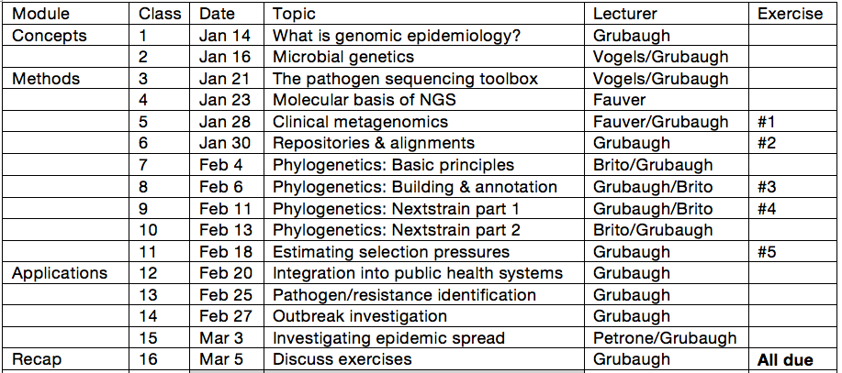
Schedule (part 1)
No midterm exam

Slide 29
Exercises
Clinical metagenomic analysis using Idseq
Public repositories and multi-sequence alignments
Phylogenetic tree reconstruction
Interactive phylogenetics using Nextstrain
Estimating selection using Datamonkey
Will start each in class (please prep before!)
Will start lectures 11-15 with 20m of discussion
All due on Mar 5th before class
Informal Nextstrain presentations during Mar 6th class

Slide 30
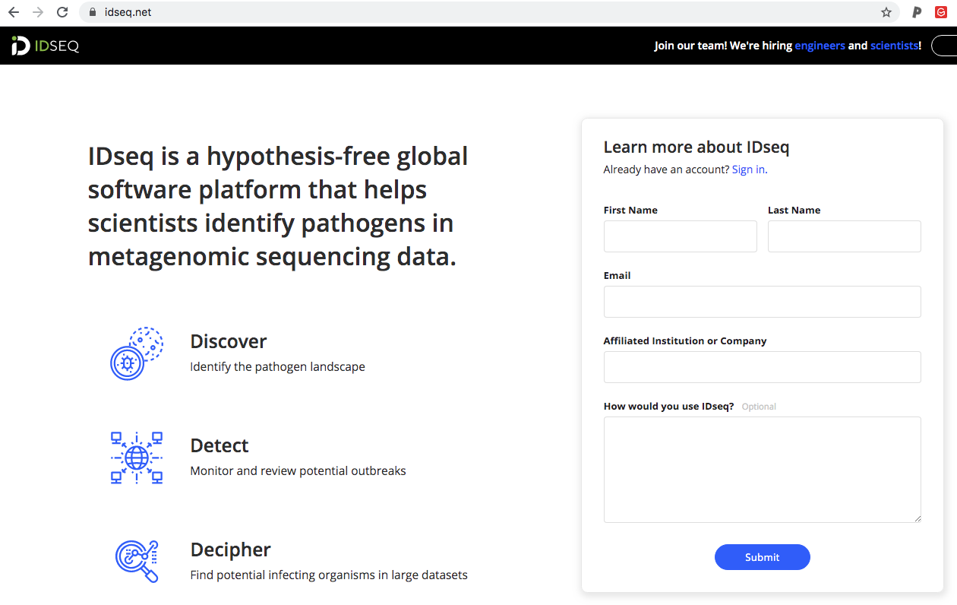
Exercises
For exercise 1, we will be using IDseq, a cloud-based metagenomics program.
You will receive your log-in from IDseq via email.

Slide 31
Exercises
For exercises #2-5, will need to identify a pathogen and question (spatial/temporal) that can be answered with data in a public repository.
Example questions – start thinking about these now!:
When did pathogen X outbreak in location Y start?
What was the likely origin of pathogen X into location Y?
Are all pathogen X outbreaks in region Z related?
Class example = When was Zika virus introduced into Brazil?
Considerations:
Virus = complete genome or segment coding sequence
Bacteria/protozoa = focus on single gene

Slide 32
Exercises
Repositories
Virus
https://www.ncbi.nlm.nih.gov/genome/viruses/variation/
https://www.ncbi.nlm.nih.gov/labs/virus/vssi/#/find-data/virus
https://www.viprbrc.org/brc/home.spg?decorator=vipr
Bacteria
https://www.ncbi.nlm.nih.gov/genome/microbes/
https://bacteria.ensembl.org/index.html
http://mbgd.genome.ad.jp/

Slide 33
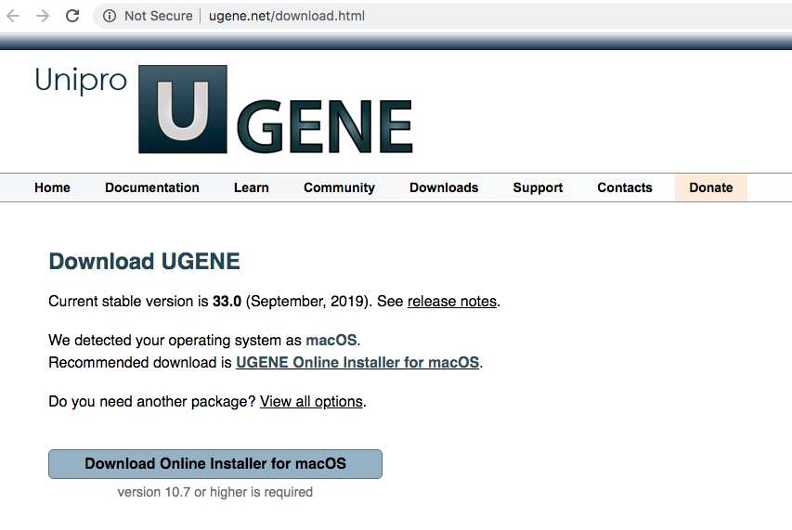
Exercises
For exercises 2-3, you will need to download UGene

Slide 34
Exercises
For exercise 4, you will build a Nextstrain community page
Main website: https://nextstrain.org/
West Nile virus: https://nextstrain.org/WNV/NA
Tuberculosis: https://nextstrain.org/tb/global
Community pages from the Grubaugh Lab:
Powassan virus in New England: https://nextstrain.org/community/grubaughlab/powassan-genomics
Dengue virus 1 in Brazil: https://nextstrain.org/community/grubaughlab/DENV-genomics/DENV1-Brazil
Zika virus in Puerto Rico: https://nextstrain.org/community/grubaughlab/ZIKV-PR
Get started on the installation ASAP
https://github.com/grubaughlab/nextstrain_course

Slide 35
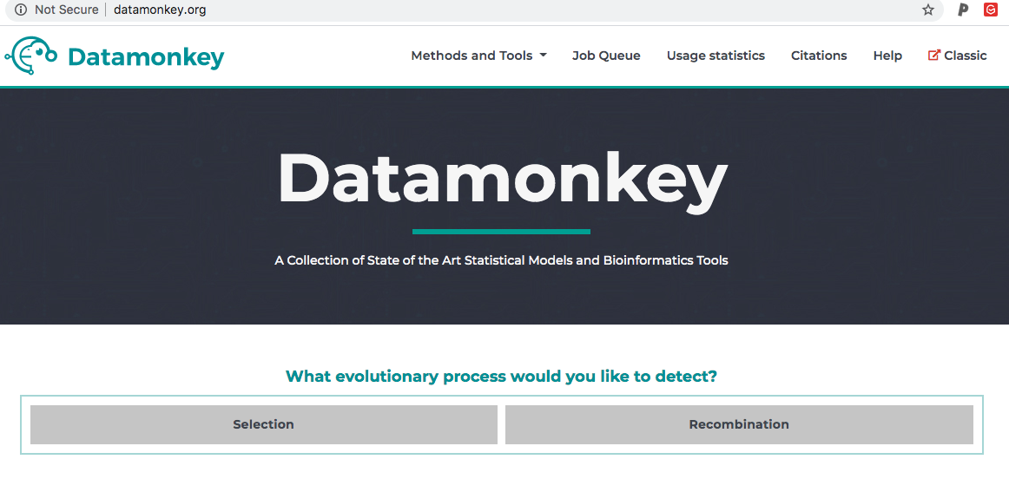
Exercises
For exercise 5, you will use Datamonkey
This is an open-source online tool, no registration or downloads are needed.

Slide 36
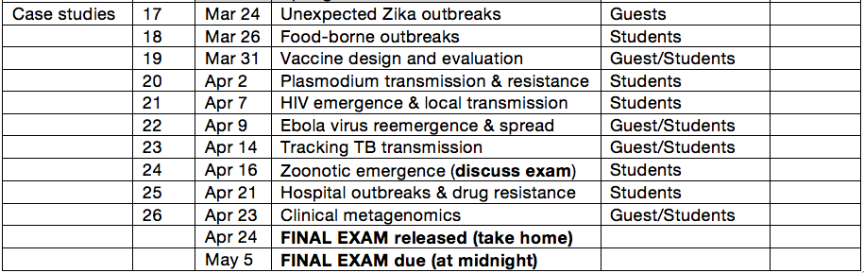
Schedule (part 2)

Slide 37
Case study presentations
Use a paper as a guide to answer the following:
Problem: What problem do the authors address in the paper?
Design: What is the study design and how did the authors use genomics to address the problem?
Inform: What did the results reveal and how did (or could) this information inform public health or clinical decisions?
Future: How could you build upon this to improve future investigations or control measures?
Public: How would you present this information to the general public?
30 minute presentation (lecture + discussion)
Individual or small groups (depending on class size)

Slide 38
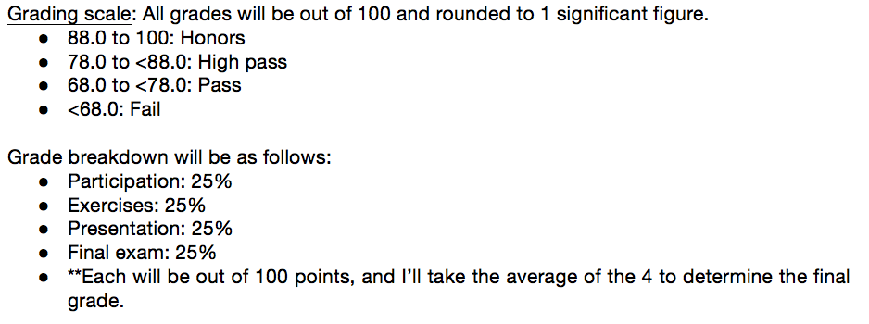
Student evaluations

Slide 39
How to be successful?
Come to class ready to participate
Bring your computer!
Read ahead (especially exercises)
Don’t wait until the last minute
Ask questions

Slide 40
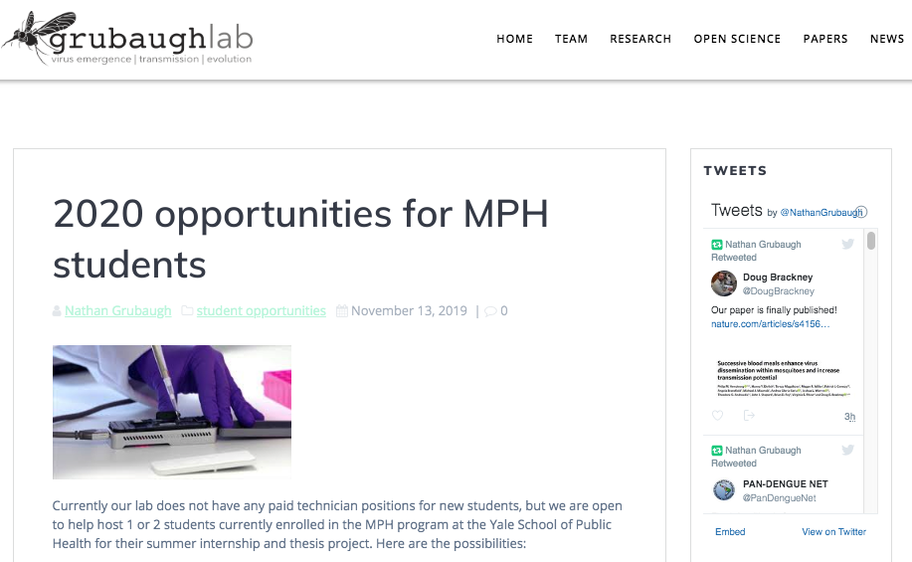
Summer internships
Thesis projects
http://grubaughlab.com/2020-opportunities-for-mph-students/

